Slide 1
Eukaryotic Cells

Slide 2
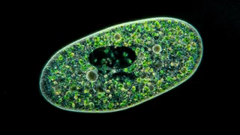
In this Smart Lesson you will learn how to:
1. | Outline the main difference between prokaryotic and eukaryotic cells.
2. | Name the kingdoms that involve eukaryotic cells.
3. | Identify where DNA is stored in a eukaryote compared to a prokaryote.

Slide 3
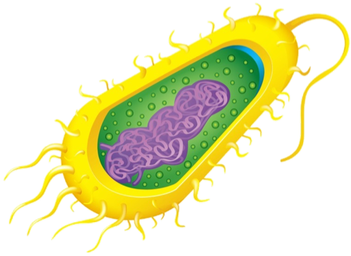
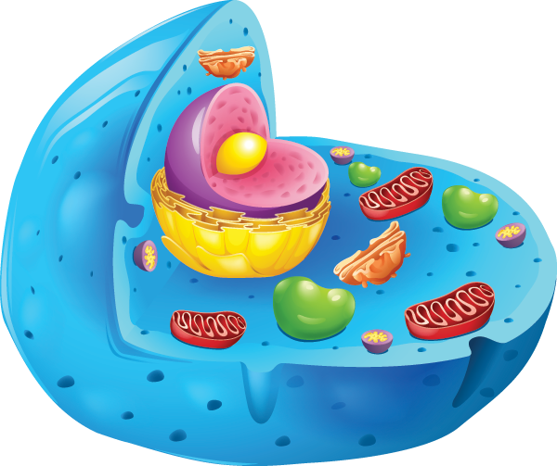
The main difference between prokaryotic cells and eukaryotic cells is that eukaryotic cells have membrane-bound organelles like a nucleus, while prokaryotic cells do not.
The name eukaryote actually means "true nucleus."
Prokaryotic Cell |  | Eukaryotic Cell

Slide 4
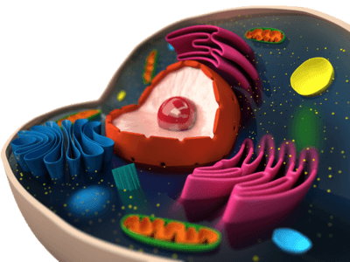
Most of the living things you see every day are made up of eukaryotic cells.
Like prokaryotic organisms, each cell looks different but has the same basic structure.
Inside a eukaryotic cell, there is much more organisation than inside a prokaryotic cell. All the different specialised parts are separated into compartments.

Slide 5
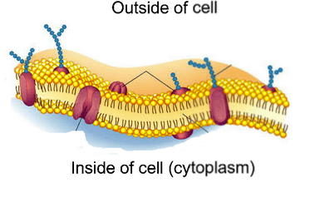
These compartments are separated from the rest of the cell by membranes.
A membrane is defined as "a sheet-like structure acting as a boundary or partition." The cell membrane is the membrane around the outside of the cell that separates the inside of the cell from the outside.
Inside eukaryotic cells, there are many organelles with special functions that are separated from the rest of the cell by a membrane. These are called membrane-bound organelles.
The outer cell membrane is made up of two layers of molecules called phospholipids.

Slide 6
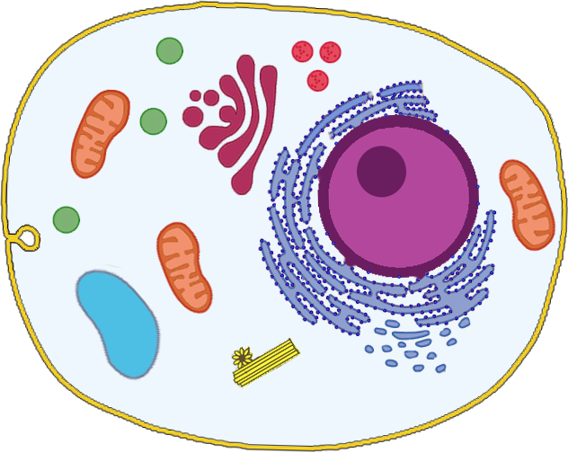
Membrane bound organelles.
Below is a list of membrane-bound organelles, in eukaryotic cells.
Nucleus
Endoplasmic
Reticulum
Golgi Apparatus
Mitochondria
Plastids
Lysosomes
Vacuoles
Endosomes

Slide 7
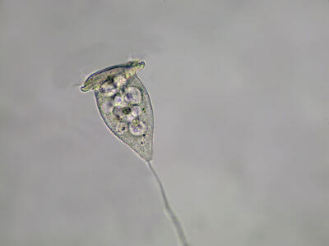
Unlike simple prokaryotic cells, eukaryotic cells are complex enough to work together with other cells and form multicellular organisms.
All multicellular organisms are made up of eukaryotic cells. However, some eukaryotic organisms can also be unicellular, such as the organisms in the kingdom Protista.

Slide 8
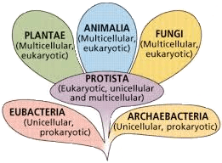
Organisms in the kingdoms Plantae, Animalia, Fungi and Protista are made up of eukaryotic cells.
They are divided into these kingdoms based on their cell structure. This means that although all their cells are similar at the fundamental level, organisms in each kingdom have slightly different cells.
You will learn about the specific characteristics of animal, plant and fungal cells in later Smart Lessons. For now, just remember that they are all eukaryotic!

Slide 9
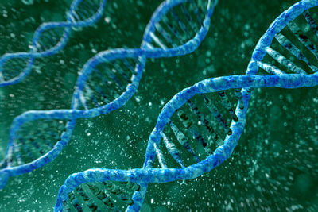
One of the main differences between prokaryotic and eukaryotic cells is how the DNA is stored.
DNA is the genetic material that contains all the instructions for the cell's structure and function.

Slide 10
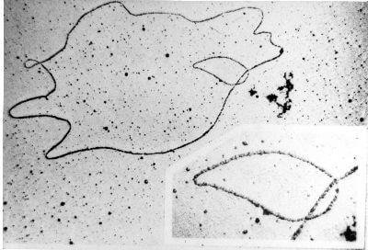
In prokaryotic cells such as bacteria, there are no membrane-bound organelles.
This means they have no nucleus.
Bacterial DNA is found in one long, circular chromosome. A chromosome is a thread-like structure of tightly coiled DNA. There is no nucleus, so the DNA is found floating in the cytoplasm in a region of the cell called the nucleoid. The nucleoid is not an organelle.

Slide 11


Slide 12
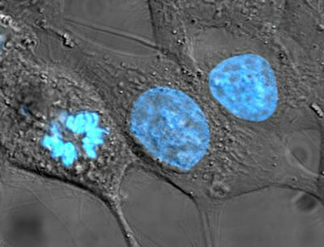
Prokaryotic vs. eukaryotic DNA
The DNA in prokaryotes is easily accessible so that the cells can divide and reproduce very quickly. However, it also means that there is more potential for the DNA to be damaged.
In eukaryotic cells, the DNA is located inside the nucleus. The nucleus has a nuclear membrane separating it from the rest of the cell. This allows the DNA to be protected from damage as well as having other advantages for the cell.

Slide 13
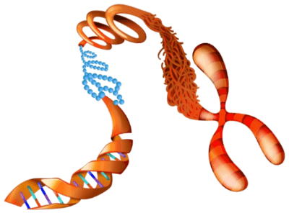
Inside the nucleus of eukaryotic cells, the DNA is found wound up into several linear chromosomes.
Humans have 46 chromosomes in most cells.
Chromosomes compact the DNA to make sure it fits in the cell. If the DNA inside one of your cells was completely unwound, it would be 2 m long!
Chromosomes also help ensure the DNA is accurately copied without mistakes or damage during cell division. You will learn more about this process later.

Slide 14
